Slide 1
Differential Privacy in Machine Learning
-Sumit Agrawal
Akshay Bhandary

Slide 2
What is the Problem
Machine Learning algorithms are used to understand and form relationships, and patterns in large datasets. But, these algorithms also learn specific training examples by default, which, if not ignored, can lead to information about the training set being revealed once the model is deployed for public use.
Researchers have proposed and deployed different approaches to protect the privacy of the dataset in learning algorithms. Unfortunately, all these approaches are vulnerable to composition attacks.
Another problem that comes with releasing data, even after the data is "anonymized," is that there is a limit to the anonymization which can be easily overcome by combining data from a different source.
Notes:
Akshay

Slide 3
Why is this problem related to this class
Data Mining is the process of extracting and discovering patterns in large datasets using advanced learning algorithms and machine learning models. Our project will try to classify handwritten digits from the MNIST database using a machine learning algorithm known as CNN, an advanced form of a Neural Network taught in class. Optimizing algorithms such as Gradient Descent are also used in conjunction with CNN for many applications; we will use it to address security and privacy concerns. Our topic (DP in ML) is primarily concerned with the security of the databases used to train such complex machine learning models and is currently being researched and worked on. Therefore, we will be using many concepts and challenges taught as part of the syllabus for this class.
Notes:
Akshay

Slide 4
Area or Scope of Investigation
We will be trying to implement differential privacy by adding noise and then evaluating the model’s accuracy when trained by differentially private data and trained by unchanged data. We will also be assessing the loss of information that may occur for a differentially private dataset.
Notes:
Akshay

Slide 5
Definition of the Problem
The problem we face is ensuring the privacy of sensitive information in datasets used to build machine learning models. Our project revolves around solving the privacy and security issues raised while creating/building machine learning models to solve more significant problems. Although there have been different approaches to solve these issues, most of them have severe shortcomings concerning the feasibility of the solution and trade-off with privacy and accuracy of the model.
Notes:
Akshay

Slide 6
Our Solution to solve the problem
To solve the problem of ensuring the privacy of sensitive information in datasets used to build machine learning models, we are using the concept of differential privacy to make it exponentially difficult for any unauthorized person to identify any individuals or find patterns in the dataset that could be used with other datasets to identify individuals, thus ensuring privacy.
We will be doing so by adding noise randomly in the dataset that will deter any adversary from inferring any information about any individual while also taking care of the trade-off between accuracy and privacy to make sure that the model will be able to classify data with equal accuracy with the perturbed data as with collected data.
Notes:
Akshay

Slide 7
Where our solution is different from others
Other solutions to solve the problem involve changing databases by removing attributes from the databases that could identify individuals uniquely or could be used to find patterns that could be used in conjunction with other databases to identify individuals; such attempts are called composition attacks.
Combined with the fact that removing attributes from the database also affects accuracy adversely since important information may be omitted during the learning/training phase of the model, it makes other solutions less effective as compared to ours since, in our project, the loss of information and accuracy are both at a negligible level.
Notes:
Akshay

Slide 8
Why our solution is better
The goal of differential privacy in a model is to ensure that the dataset is indistinguishable from whether a single observation is present or not. As an added benefit, differential privacy has several properties like composability and group privacy, making it a viable alternative from both a commercial standpoint and a data mining point of view.
Our solution to the problem of ensuring privacy involves adding noise randomly to the database at a level that will make it difficult for an adversary to infer any knowledge from the database but at the same time not affect the model’s training, learning, and accuracy by a large extent, thus making it viable and feasible from a data mining point of view.
Notes:
Sumit

Slide 9
Single Hypothesis
Using the idea behind differential privacy in machine learning, we will be adding noise to a dataset to significantly reduce the likelihood of re-identification of individuals or identification of patterns that could potentially be used to identify information about individuals in the dataset
Notes:
Sumit

Slide 10
Positive/Negative Hypothesis
Positive: By adding noise, we hypothesize that the privacy of sensitive and confidential information of individuals on whose data the database has been made will be guaranteed to a much stronger degree than the previous approach using algorithms meant to anonymize data like k-anonymity.
Negative: Although privacy will be guaranteed for individuals’ private information, the caveat with this method is that the machine learning model will be slightly less accurate than if the model had been trained with non-perturbed data.
Notes:
Sumit

Slide 11
How to Generate/collect input data
We will be using the MNIST dataset to train the model to detect and classify the digits of handwritten numbers, which has 60 thousand grayscale images of handwritten single digits between 0 and 9, thus satisfying our requirement for a large dataset.
Notes:
Sumit

Slide 12
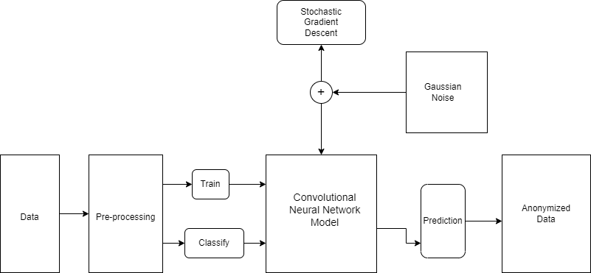
How to solve the problem-Algorithm design
We will start by downloading and converting the MNIST datasets into two data loaders for training and testing using Pytorch.
Following this, we will be training a convolution neural network to classify the dataset accordingly using the PyTorch library to build and train the model also, implementing the optimization algorithm such as Stochastic Gradient Descent.
Once the training is completed, we will test the model against the MNIST database and calculate the classification's accuracy
Notes:
Sumit

Slide 13
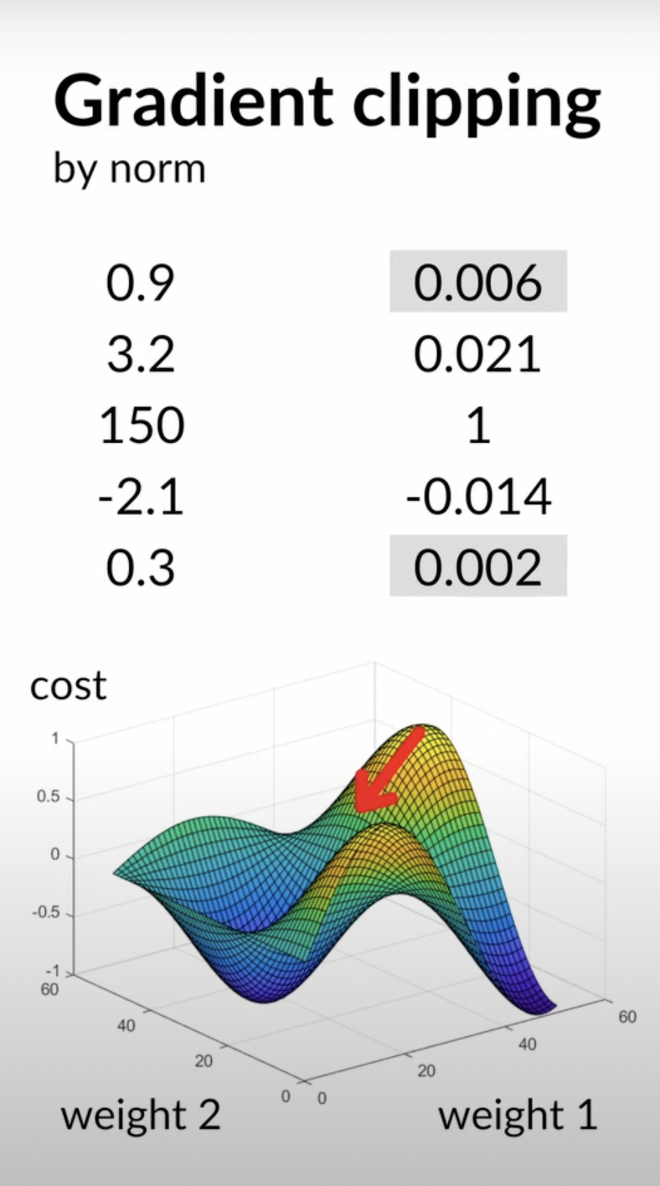
We first perform Gradient Clipping for the next phase, a technique used to prevent exploding gradients.So, if the value of gradient g is greater than the hyperparameter c, then the value of the gradient is changed as below:
g ↤ c · g/‖g‖
After the gradient clipping process has been completed, we will add noise to the MNIST database. While calculating the noise to be added, we will be using the privacy budget (ϵ, epsilon) to ensure that the change in the model's output should not vary by a vast amount.
Finally, using the changed database, we will retrain the model, evaluate the accuracy and loss of information, if any, and compare it with the previous training results
Notes:
Sumit

Slide 14
Language and Tools used
We will be using Python as the programming language to implement differential privacy. It has excellent support libraries, enabling us to implement algorithms such as Stochastic Gradient Descent and help train a Convolution Neural Network.
The tools we will be using are listed below:
Google Colab
Opacus Library
NumPy
Matplotlib
PyTorch
Notes:
Sumit

Slide 15
Implementation
Our project that shows how differential privacy is used in the machine has been designed using the following steps:
First, we downloaded and converted the MNSIT dataset into two portions of approximately 85% meant for training and 15% for testing using the python library PyTorch to convert the dataset into dataloaders.
After converting and splitting the dataset, we trained a basic convolution neural network to classify the dataset accordingly using PyTorch to build and train the model. This is done to establish a base line for comparing against the model which will be trained with a differentially private data.

Slide 16
After completion of training, we tested the model against the MNIST database and calculated the classification's accuracy.
For the next phase of the project, we performed Gradient Clipping by norm to prevent exploding gradients. This was done because while using the Stochastic Gradient descent algorithm as the optimization algorithm for the CNN model, we have to make sure that the algorithm finds the global minima and does not move towards the local minima or any other direction.

Slide 17
Following that, we added noise to the MNIST data. This noise added, was calculated using the privacy budget (ϵ, epsilon) to make sure that the model’s output should not vary by a vast amount.
Finally, we retrained the model using the database to which noise was added, and then evaluated the accuracy and loss of information, then compared it with the previous training results to understand the efficacy of differential privacy in machine learning.

Slide 18
Output Generation
The output for the project will showcase the efficacy of differential privacy in machine learning by showing the following:
1. The accuracy of the model when trained with a normal dataset
2. Loss of Information incurred while training with a normal dataset
3. The accuracy of the model when trained with a differentially private dataset
4. Loss of Information incurred while training with a differentially private dataset
5. The images of handwritten digits before and after the addition of varying levels of noise

Slide 19
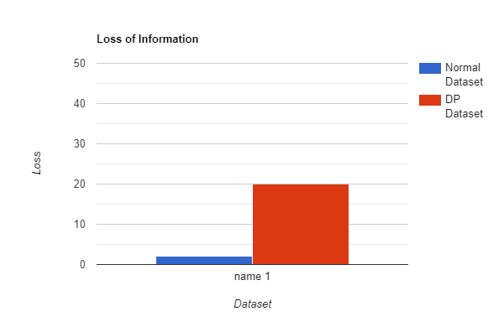
Output Analysis
The loss of information for both the models can be seen on left.This is obtained after the model has been trained with both a normal dataset and with a differentially private dataset.
Here we see that the loss of information is 20%, which is greater than the loss of information when the model was trained without noise. This is the trade-off that we have made with privacy, the addition of noise, accuracy, and loss of information.

Slide 20
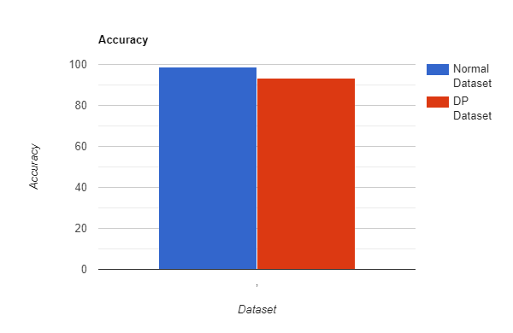
Here we can see that the accuracy of the model has dropped to 93.4% which is less than that when the model was trained on the original dataset, however, an accuracy of 93.4% makes the model viable from a data mining point of view

Slide 21
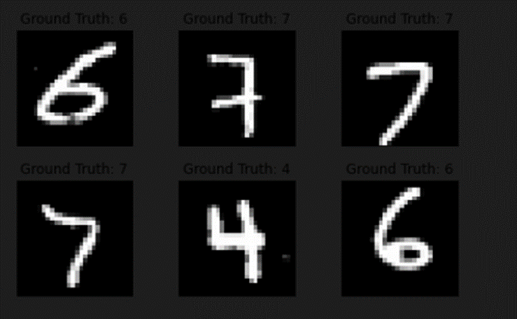
Compare against Hypothesis
As we can ascertain from the screenshot on the left, the ground truth that is the images of handwritten digits from the MNIST dataset are clear.

Slide 22
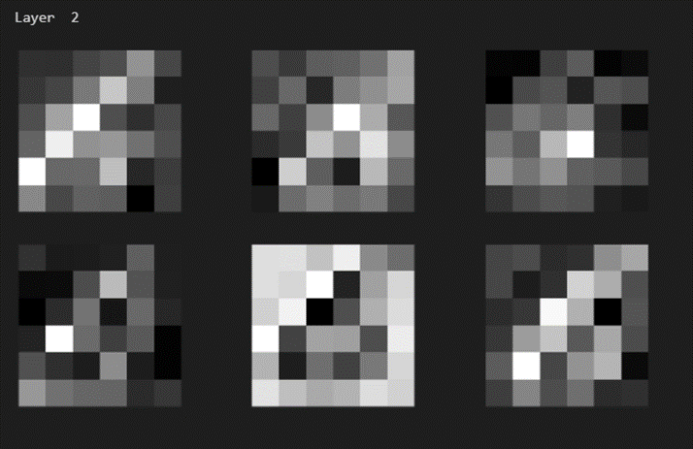
But, as can be seen from the images of the second layer of the CNN, the addition of noise makes the image too noisy and too blurry for human eyes to ascertain which number is being shown, thus proving that the addition of noise does impact the dataset which makes it exponentially difficult for an unauthorized person to ascertain any information that could lead to the identification of individuals from the differentially private dataset.

Slide 23
Conclusions-Summary
To summarise, what we have shown here is that it is indeed possible for a data scientist to create machine learning models that can learn general relationships between data without having to learn specific relationships like for example, a model that is built to learn to detect cancer will learn that people who smoke are more susceptible to get lung cancer or people who chew tobacco are a higher risk to get mouth cancer, without having access to specific details like Bob Barker is a chain smoker and therefore is more susceptible to get lung cancer. This is how the privacy of individuals will be saved.

Slide 24
Also, from a data scientist’s point of view, we are more interested in the patterns that occur most often in a dataset, which closely mirrors the generalization that we need in machine learning and statistics and not the one-off relationships that could be found in a dataset, which is why this approach is realistic.

Slide 25
Recommendation for future studies
The first goal for future studies would be to try and reduce the loss of information on a differentially private dataset by using the privacy budget in an incremental way to reduce the loss of information.
However, the main goal of future studies for differential privacy in machine learning is not only to address privacy concerns on the dataset but also to develop a method wherein multiple people can combine their private inputs to compute a function without having to reveal their inputs to each other. This can be done using encryption and cryptographic mathematics. This will enable the different parties to work on the encrypted dataset to build models with the caveat being that the only method to decrypt the dataset for any reason would be for all parties concerned to come together and agree to do so.

Slide 26
Thank You

